Slide 1




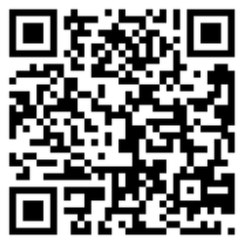
FIT FOR DUTY
DON’T
LET
FATIGUE
FLY
DOWNLOAD OUR APP AND SUPPORT THE CAMPAIGN FOR HEALTHIER PILOTS AND SAFER SKIES:

Slide 2
Download our new fatigue reporting app now and support BALPA’s campaign for healthier pilots and safer skies.
What is the problem?
Increased demand for flights combined with tighter schedules and years of cost cutting by airlines means more pressure on pilots and the risk of greater levels of fatigue – and the unacceptable safety and health consequences that come with it.
What do we want to happen?
The Civil Aviation Authority is reviewing the UK flight time limitations (FTL) rules and fatigue risk management requirements. We need to show them the extent of fatigue among pilots, and the urgent need for change. This problem is fixable. With improved rules, and action from airlines, we can have safer flights flown by pilots who are properly rested and who are able to enjoy healthy careers with their employer.
How can you help?
We have launched a bespoke app for pilots to log fatigue, to help us establish a clear picture of the issue across the whole industry. It's quick and easy to use, anonymous, and the data you provide will be crucial in helping us make the case for necessary changes to FTL and fatigue risk management by airlines.
We need as many pilots as possible to use the app. Please encourage colleagues to participate (whether they are members of BALPA or not). Please also continue to report fatigue to your airline in the usual way so that operators are made aware of urgent issues and the scale of the problem.
https://www.balpa.org/campaign/fighting-pilot-fatigue
With better, updated rules and action from airlines, we can have healthier pilots and safer skies.

